Slide 1
Using Java™ Technology Reflection to Improve Design
Michael T. Portwood, MS
Exuberance, LLC

Slide 2
Agenda
What is reflection
History of reflection
How to use reflection
Myths about reflection
Advanced reflection issues
Improvements to reflection
Conclusion

Slide 3
What Is Reflection
Java™ Technology provides two ways
to discover information about an object
at runtime
  Traditional runtime class identification
    The object’s class is available at compile
    and runtime
    Most commonly used
  Reflection
    The object’s class may not be available
    at compile or runtime

Slide 4
What Is Reflection
“Reflection in a programming language context refers to the ability to observe and/or manipulate the inner workings of the environment programmatically.”¹
“The reflection API represents, or reflects, the classes, interfaces, and objects in the current Java™ virtual machine.”²
1. J. R. Jackson, A. L. McClellan, Java™ 1.2 By Example, Sun Microsystems, 1999.
2. M. Campione, et al, The Java™ Tutorial Continued, Addison Wesley, 1999.

Slide 5
The History of Reflection
Introduced in JDK™ 1.1 release to support the JavaBeans™ specification
Used throughout the JDK™ software and Java runtime environment (JRE)
  Java™ Foundation Classes API (JFC)
  Jini™ connection technology
  JavaMail™ API
  JDBC™ API
Improved in Java 1.2 SDK
Further refined in Java 1.3 SDK

Slide 6
Why Runtime Class Identification
Java™ technology takes advantage
of polymorphism
  New subclasses easily added
  Bulk of behaviors inherited from
  its superclass
  No impact on other subclasses of
  the superclass
  At runtime, the JVM™ takes advantage
  of late dynamic binding
  Messages are directed to the
  correct method

Slide 7
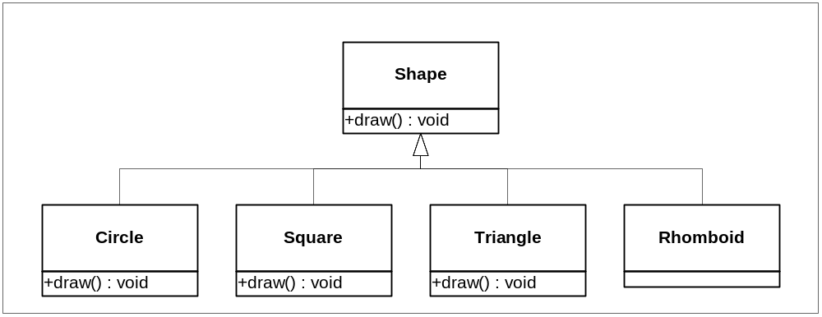
Example UML

Slide 8
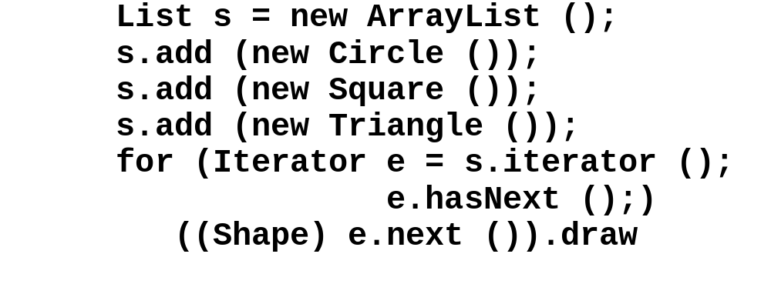
Runtime Class Identification Example Code
Class loading occurs at first instantiation
When the object is retrieved from the list, it is cast to the superclass, Shape
The object remembers its class and responds with the correct draw method

Slide 9
How the Class Object Works
Every class loaded into the JVM™ has a Class object
  Corresponds to a .class file
  The ClassLoader is responsible for finding and loading the class into the JVM™
At object instantiation…
  The JVM™ checks to see if the class is already loaded into the virtual machine
  Locates and loads the class if necessary
  Once loaded, the JVM™ uses the loaded
  class to instantiate an instance

Slide 10
Proof of Dynamic Loading
public static void main (String[] args)
{
System.out.println ("inside main");
new A ();
System.out.println ("After creating A");
try
{
Class.forName ("B");
}
catch (ClassNotFoundException e)
{
e.printStackTrace ();
}
System.out.println ("After forName (\"B\")");
new C ();
System.out.println ("After creating C");
}

Slide 11
Late Dynamic Binding
The JRE does not require that all classes are loaded prior to execution
  Different from most other environments
Class loading occurs when the class is first referenced
Late Dynamic Binding is…
  Important for polymorphism
    Message propagation is dictated at runtime
    Messages are directed to the correct method
  Essential for reflection to be possible

Slide 12
Class Literals
Using Class Literals is the second way to reference an object’s class
  Added in the JDK™ 1.1 release
All classes, interfaces, arrays, and primitive types have class literals
Primitive types have corresponding wrapper classes
Examples:
    Triangle.CLASS
    int.TYPE

Slide 13
The instanceof Keyword
The instanceof keyword is the third way to reference an object’s class
Used with both classes and interfaces
Returns true if the object is a species of a
specified class
  Subclasses will also answer true
  Code becomes structurally bound to the class hierarchy
Several limitations on the referenced class
  Must be a named class or interface
  The class constant cannot be the Class class
Example:
  if (x instanceof Circle)
    ((Circle) x).setRadius (10);

Slide 14
The Reflection API
The reflection API is the fourth way to reference an object’s class
Reflection allows programs to interrogate and manipulate objects at runtime
The reflected class may be…
  Unknown at compile time
  Dynamically loaded at runtime

Slide 15
Core Reflection Classes
java.lang.reflect
  The reflection package
  Introduced in JDK 1.1 release
java.lang.reflect.AccessibleObject
  The superclass for Field, Method, and Constructor classes
  Suppresses the default Java language access control checks
  Introduced in JDK 1.2 release

Slide 16
Core Reflection Classes (Cont.)
java.lang.reflect.Array
  Provides static methods to dynamically create and access Java arrays
java.lang.reflect.Constructor
  Provides information about, and access to, a single constructor for a class

Slide 17
Core Reflection Classes (Cont.)
java.lang.reflect.Field
  Provides information about, and dynamic access to, a single field of a class or
  an interface
  The reflected field may be a class (static)
  field or an instance field

Slide 18
Core Reflection Classes (Cont.)
java.lang.reflect.Member
  Interface that reflects identifying information about a single member (a field or a method)
  or a constructor
java.lang.reflect.Method
  Provides information about, and access to, a single method on a class or interface
java.lang.reflect.Modifier
  Provides static methods and constants
  to decode class and member
  access modifiers

Slide 19
Core Reflection Classes (Cont.)
JDK 1.3 release additions
  java.lang.reflect.Proxy
    Provides static methods for creating dynamic proxy classes and instances
    The superclass of all dynamic proxy classes created by those methods
  java.lang.reflect.InvocationHandler
    Interface
    Interface implemented by the invocation handler of a proxy instance

Slide 20
Commonly Used Classes
java.lang.Class
  Represents classes and interfaces within a running Java™ technology-based program
java.lang.Package
  Provides information about a package that can be used to reflect upon a class or interface
java.lang.ClassLoader
  An abstract class
  Provides class loader services

Slide 21
Using Reflection
Reflection allows programs to interrogate an object at runtime without knowing the object’s class
How can this be…
  Connecting to a JavaBean™ technology- based component
  Object is not local
    RMI or serialized object
  Object dynamically injected

Slide 22
What Can I Do With Reflection
Literally everything that you can do if you know the object’s class
  Load a class
  Determine if it is a class or interface
  Determine its superclass and implemented interfaces
  Instantiate a new instance of a class
  Determine class and instance methods
  Invoke class and instance methods
  Determine and possibly manipulate fields
  Determine the modifiers for fields, methods, classes,
  and interfaces
  Etc.

Slide 23
Here Is How To…
Load a class
  Class c = Class.forName (“Classname”)
Determine if a class or interface
  c.isInterface ()
Determine lineage
  Superclass
    Class c1 = c.getSuperclass ()
  Superinterface
    Class[] c2 = c.getInterfaces ()

Slide 24
Here Is How To…
Determine implemented interfaces
  Class[] c2 = c.getInterfaces ()
Determine constructors
  Constructor[] c0 = c.getDeclaredConstructors ()
Instantiate an instance
  Default constructor
    Object o1 = c.newInstance ()
  Non-default constructor
    Constructor c1 = c.getConstructor (class[]{…})
    Object i = c1.newInstance (Object[] {…})

Slide 25
Here Is How To…
Determine methods
  Methods[] m1 = c.getDeclaredMethods ()
Find a specific method
  Method m = c.getMethod (“methodName”,
  new Class[] {…})
Invoke a method
  m.invoke (c, new Object[] {…})

Slide 26
Here Is How To…
Determine modifiers
  Modifiers[] mo = c.getModifiers ()
Determine fields
  Class[] f = c.getDeclaredFields ()
Find a specific field
  Field f = c.getField()
Modify a specific field
  Get the value of a specific field
    f.get (o)
  Set the value of a specific field
    f.set (o, value)

Slide 27
Four Myths of Reflection
“Reflection is only useful for JavaBeans™ technology-based components”
“Reflection is too complex for use in
general purpose applications”
“Reflection reduces performance
of applications”
“Reflection cannot be used with the 100% Pure Java™ certification standard”

Slide 28
“Reflection Is Only Useful for JavaBeans™ Technology-based Components”
False
Reflection is a common technique used in other pure object oriented languages like Smalltalk and Eiffel
Benefits
  Reflection helps keep software robust
  Can help applications become more
    Flexible
    Extensible
    Pluggable

Slide 29
“Reflection Is Too Complex for Use in General Applications”
False
For most purposes, use of reflection requires mastery of only several method invocations
The skills required are easily mastered
Reflection can significantly…
  Reduce the footprint of an application
  Improve reusability

Slide 30
“Reflection Reduces the
Performance of Applications”
False
Reflection can actually increase the performance of code
Benefits
  Can reduce and remove expensive
  conditional code
  Can simplify source code and design
  Can greatly expand the capabilities
  of the application

Slide 31
“Reflection Cannot Be Used With the 100% Pure Java™ Certification Standard”
False
There are some restrictions
  “The program must limit invocations to
  classes that are part of the program or
  part of the JRE”³
3. Sun Microsystems, 100% Pure Java™ Certification Guide, version 3.1, May 2000.

Slide 32
Advanced Reflection Issues
Why use reflection
Using reflection with object-oriented design patterns
Common problems solved using reflection
  Misuse of switch/case statements
  User interface listeners

Slide 33
Why Use Reflection
Reflection solves problems within
object-oriented design:
  Flexibility
  Extensibility
  Pluggability
Reflection solves problems
caused by…
  The static nature of the class hierarchy
  The complexities of strong typing

Slide 34
Use Reflection With Design Patterns
Design patterns can benefit
from reflection
Reflection can …
  Further decouple objects
  Simplify and reduce maintenance

Slide 35
Design Patterns and Reflection
Many of the object- oriented design patterns can benefit from reflection
Reflection extends
the decoupling of objects that design patterns offer
Can significantly simplify design patterns
Factory
Factory Method
State
Command
Observer
Others

Slide 36
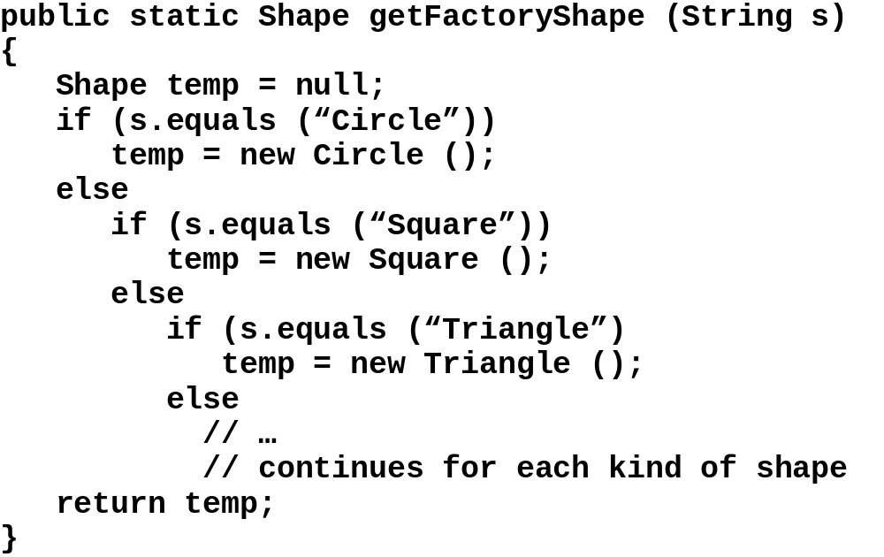
Factory Without Reflection

Slide 37
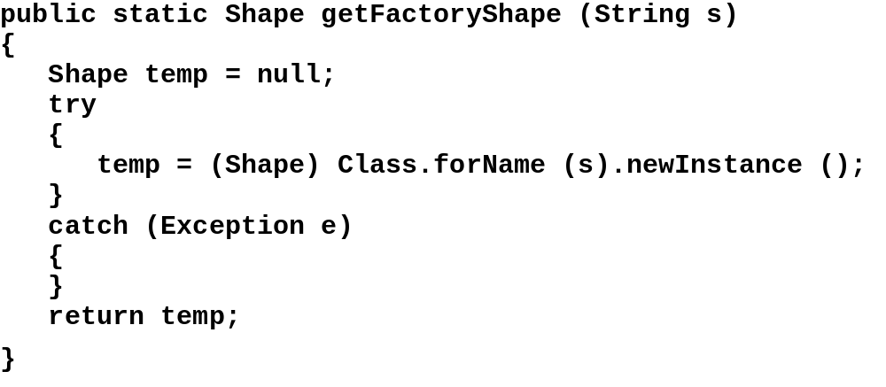
Factory With Reflection

Slide 38
Design Pattern Implications
Product classes can be added, changed, or deleted without affecting the factory
  Faster development (one factory fits all)
  Reduced maintenance
  Less code to develop, test, and debug

Slide 39
Design Strategies for Using Reflection
Challenge switch/case and cascading
if statements
  Rationale
    The switch statement should scream “redesign me” to the developer
    In most cases, switch statements perform pseudo subclass operations
  Steps
    Redesign using an appropriate class decomposition
    Eliminate the switch/case statement
    Consider a design pattern approach
  Benefits
    High level of object decoupling
    Reduced level of maintenance

Slide 40
Challenge UI Listeners
Can a generalized listener function for several components or does each component need a unique listener?
  Consider using the Command design pattern
  Steps
    Use the setActionCommand method to set the method to reflect upon for each component
    Instantiate only one instant of the listener
  Benefits
    Smaller program memory footprint
    Faster performance due to less class loading
    Behavior placed in the appropriate place

Slide 41
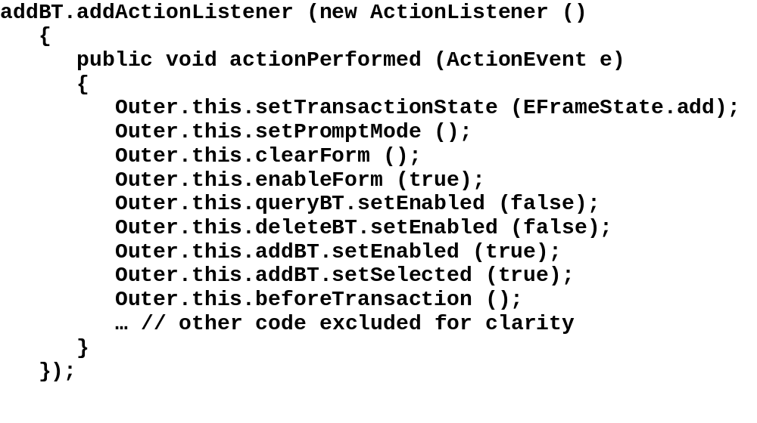
Listener Without Reflection

Slide 42
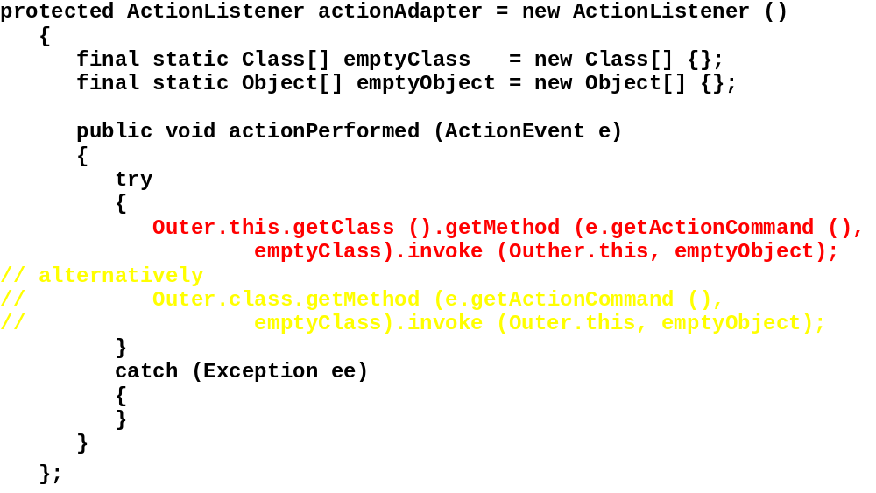
Listener With Reflection

Slide 43
Improvements to Reflection in JDK™ 1.2 Release
Numerous small changes throughout
the API
Most changes “under the hood”
Two classes added
  AccessibleObject class
    Allows trusted applications to work with private, protected, and default visibility members
  ReflectPermission class
    Complements the AccessibleObject class
    Governs the access to objects and their
    components via reflection

Slide 44
Improvements to Reflection in JDK™ 1.3 Release
Two significant additions to the API
  Proxy Class
    Implements a specified list of interfaces
    Delegates invocation of the methods
    defined by those interfaces to a separate InvocationHandler object
  InvocationHandler Interface
    Defines a single invoke method that is
    called whenever a method is invoked on
    a dynamically created Proxy object

Slide 45
Capabilities Not Available Using Reflection
What are a class’ subclasses?
  Not possible due to dynamic
  class loading
What method is currently executing
  Not the purpose of reflection
  Other APIs provide this capability

Slide 46
Review
The JRE allows 4 ways to reference a class
  The class’ class definition
  Class literals
  The instanceof keyword
  Reflection
Reflection is the only pure runtime way
  Provides full access to the object’s capabilities
  Provides runtime capabilities not
  otherwise available
  Improves the quality of an application

Slide 47
Review
Solves several design issues
  Simplifies the static complexity of methods by providing elimination of…
    Nested if/else constructs
    The switch/case construct
  Improves user interface code by…
    Removing redundant inner classes
    Reducing application footprint
    Placing behaviors where they belong
  Extends the power of classic
  object-oriented design patterns

Slide 48
Benefits of Reflection
Reflection provides…
  High level of object decoupling
  Reduced level of maintenance
  Programs become…
    Flexible
    Extensible
    Pluggable
  Software becomes “soft”

Slide 49
Question and Answer

Slide 50
Additional Information
World Wide Web site
  www.exuberance4me.com
    Presentation
    Presentation notes
    Example applications
E-mail contact
  portwood@exuberance4me.com

